Slide 1

Notes:
Hola, we are alimentos.pe

Slide 2
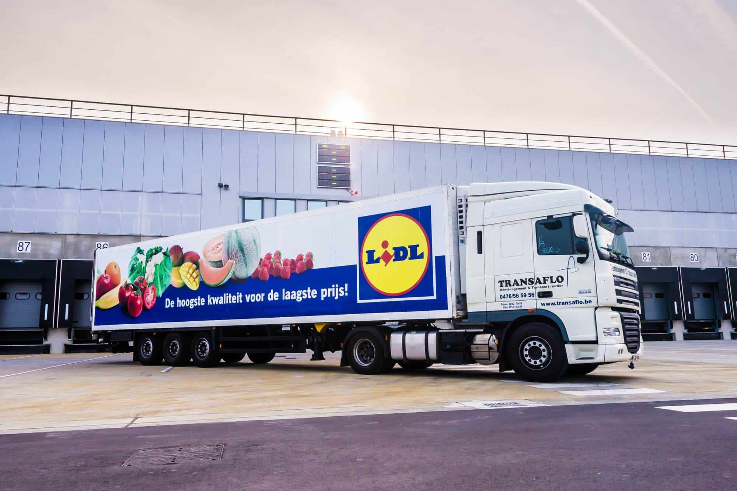
Do you trust how your food is handled to get to your table?

Slide 3









Problem
Notes:
This is Maria. A young person who has a healthy lifestyle, likes to eat fresh food, but has little time. On the other hand, Carlos is a producer, a small farmer close to the city, but with no visibility online. Here is were Alimentos.pe is the solution.

Slide 4
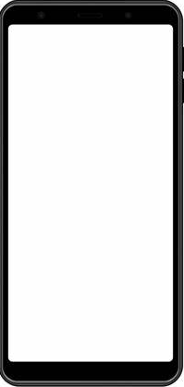
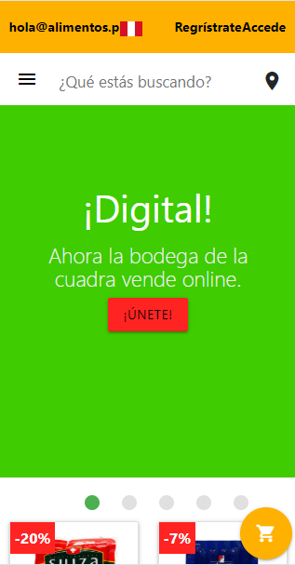







Solution
Notes:
We are an online marketplace that connects customers directly to producers. Customers gets their food delivered directly by who makes it, which is healthy, and supports a local business. Producers gets online visivility, which translates to more sales, and gets transparency of how much he’s selling.

